Slide 1
Continual Learning Techniques for Image Classification
Finlay Boyle
Supervised by Dr Donald Sturgeon
Durham University, Department of Computer Science
Notes:
Continual Learning Techniques for Image Classification

Slide 2
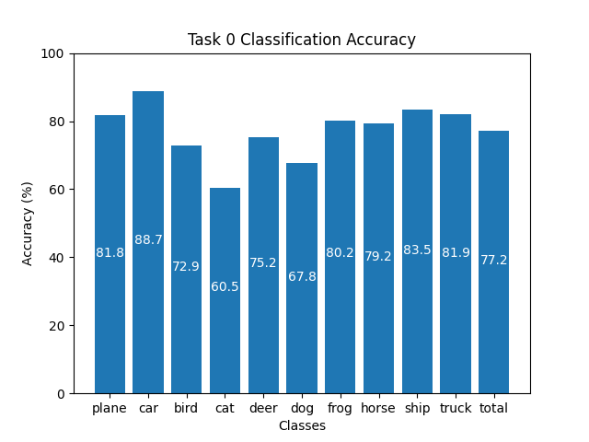

Training Machine Learning Models
Standard training technique: Offline Training
Repeated optimisation over batches
Requires access to entire dataset
High-quality results
Limitations:
Restrictive dataset requirement
Suffers from Catastrophic Forgetting
Figure 1: Offline Training on CIFAR-10 for 100 epochs
Figure 2: 20 random 32x32 image samples from CIFAR-10
Notes:
The standard method to train machine learning models to classify images is to split a dataset into batches and use these batches to repeatedly optimise the parameters of a model via backpropagation. This is known as Offline Training.
[Use Laser] As Figure 1 shows, Offline Training is capable of producing high-quality results. The chart shows the classification accuracy of a ResNet-18 model trained for 100 epochs on the CIFAR-10 dataset where it attains an average classification accuracy of over 77% and performs well on each class individually.
However, Offline Training is limited by the requirement to have the dataset available in its entirety at training time. If it is infeasible to do so, or the data is real-time then Offline Training is unsuitable due to a fe-nom-en-non known as Catastrophic Forgetting.

Slide 3
Catastrophic Forgetting
Catastrophic Forgetting: The complete and sudden loss of previously acquired knowledge in a neural network [1]
Sequentially updating with new data causes forgetting
Offline Training lacks context of prior knowledge
Ability to learn continually often ignored [2]
Notes:
Catastrophic Forgetting is defined as the complete and sudden loss of previously acquired knowledge in a neural network.
It is caused by training an already trained model on unseen data. The model overwrites the weights and biases it has learnt previously causing it to forget the knowledge it has gained. The ability of a neural network to learn continuously is often overlooked and, at a high-level, is caused by the lack of context that existing weights represent acquired knowledge.

Slide 4
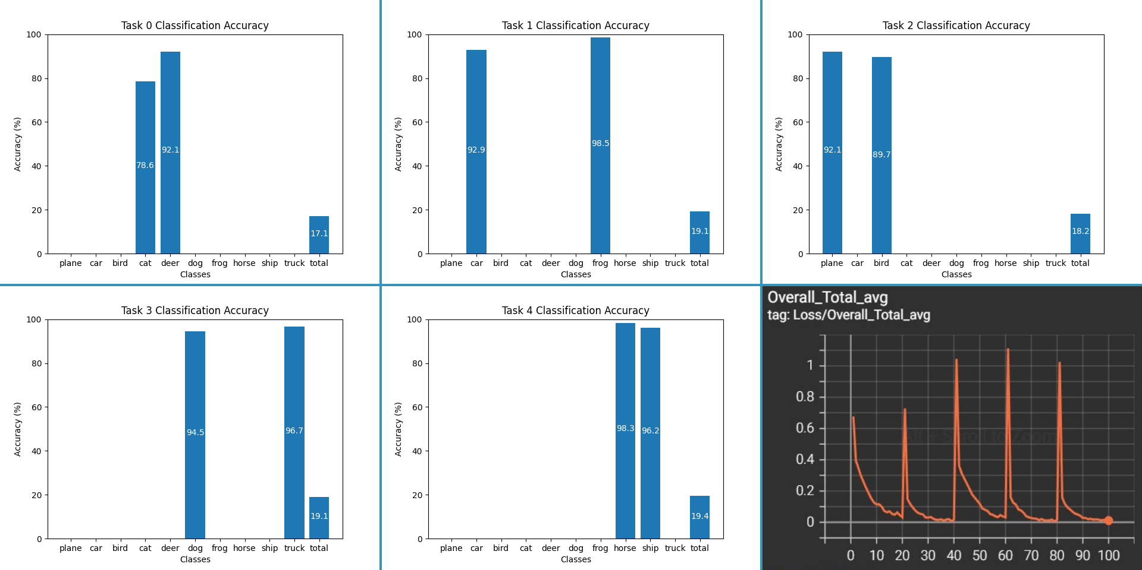
Example of Catastrophic Forgetting
Figure 3: Applying Offline Training sequentially to the same model with separate tasks causes Catastrophic Forgetting. Bottom right: Overall loss. Other images are classification accuracy.
Notes:
In this example, I have split the CIFAR-10 dataset into 5 disjoint tasks, each containing 2 classes without replacement. A ResNet-18 model is then trained sequentially on the tasks for 20 epochs each. [Use Laser] as you can see in Figure 3, the model forgets about the previous tasks and overwrites the knowledge.
The final graph shows the loss peaking as each new task is introduced and decreasing as the model is trained.

Slide 5
Continual Learning
Continual Learning: A collection of techniques to overcome Catastrophic Forgetting [3]
Rose to prominence with Elastic Weight Consolidation in 2017 [4] and is actively researched
Primarily focused on alternative methods to Offline Training
Smaller focus on network architecture [5] and dynamic networks
Does not require access to entire dataset
Notes:
Continual Learning is the study of techniques to reduce the effect of Catastrophic Forgetting while trying to match the performance of Offline Training. Elastic Weight Consolidation, a technique that penalises changes to weights that are important to previous tasks, was one of the first techniques that gave rise to the field.
The literature since then has mainly focused on alternatives to Offline Training, but there has been a recent interest into how the architecture of a model may contribute to forgetting. The main difference from Offline Training is the relaxation of the requirement for the whole dataset to be present at training time.

Slide 6
Properties
Task Formulation
Disjoint vs Blurry
Online vs Offline
Task-IL vs Class-IL

Slide 7
Existing Approaches
Venn Diagram of Regularisation, Memory, Meta-Learning
Why meta-learning isn’t useful in the online context
Highlight those that influence my technique

Slide 8
Techniques Influencing Design
L2P
GDumb
Rainbow
SCR

Slide 9
Pre-trained Vision Transformers
Why use them?
Do they defeat the point of Continual Learning → No
How are they used in L2P and how does mine differ?

Slide 10
Sample Uncertainty
Rainbow introduced uncertainty
Introduce Novel-BN
Why Batch Normalisation might be problematic (especially in CL context)

Slide 11
An Alternative Approach
Introduce Novel-RD
Why do I expect it to perform better?
Modular algorithm approach so it substitutes directly in

Slide 12
Classification and Losses
NCM classification vs (Soft)max classification
Why does SCL loss work well with NCM
Quick overview of CE loss?

Slide 13
Novel Approach
Details of the full approach
Summary of previous slides and how they all fit together

Slide 14
Experiment Setup
Details about reliability → repetition
Metrics, data being recorded
Datasets
Buffer Sizes

Slide 15
Results on CIFAR-100
Focus on figures
This is the same set of results reported in the paper CIFAR-100 5k samples
Highlight key results

Slide 16
Comparing Techniques
Give some reasonably basic comparisons between techniques
Which ones performed well and which ones struggled
How did the Novel techniques compare

Slide 17
Analysis of Forgetting
First-task forgetting figures
Highlight trends and techniques that perform well etc

Slide 18
Conclusion
Wrap up, highlight the main results: beating SotA
Future work direction

Slide 19
References
[1] McCloskey, Michael, and Neal J. Cohen. "Catastrophic interference in connectionist networks: The sequential learning problem." Psychology of learning and motivation. Vol. 24. Academic Press, 1989. 109-165.
[2] Hecht-Nielsen, Robert. "Neurocomputing: picking the human brain." IEEE spectrum 25.3 (1988): 36-41.
[3] Parisi, German I., et al. "Continual lifelong learning with neural networks: A review." Neural Networks 113 (2019): 54-71.
[4] Kirkpatrick, James, et al. "Overcoming catastrophic forgetting in neural networks." Proceedings of the national academy of sciences 114.13 (2017): 3521-3526.
[5] Mirzadeh, Seyed Iman, et al. "Architecture matters in continual learning." arXiv preprint arXiv:2202.00275 (2022).
Notes:
Thank you for listening, here are the references for the presentation.

Slide 20
Results on CIFAR-10
Same style as the CIFAR-100 main slide, gives a summary
Mainly focused on showing figures rather than raw data
Highlight a few key results

Slide 21
Results with Varied Buffer Sizes
Figures from the main report showcasing the increase in performance as more samples are introduced
Talk about SCR plateauing etc

Slide 22
Analysis of L2P Prompt Saturation
L2P prompt usage figures
What do they show?
Link with the fall off in first-task performance
Link with catastrophic forgetting

Slide 23
Analysis of Feature Spaces
PCA graphs of the feature space

Slide 24
Analysis of Resource Consumption
Comparison of run time
Comparison of memory consumption
Trade-off with results

Slide 25
Further Justification for Novel-RD
Might not be needed
Will decide based on how in-depth I go in the main presentation

Slide 26
Full Results from CIFAR-100
Copy and paste the main results table

Slide 27
Full Results from CIFAR-10
Copy and paste the main results table

Slide 28
Applications of Continual Learning
Combining historical and new data together
Medical imaging → real time

